Slide 1
Introduction to Software Testing
Why Do We Test Software?

Slide 2
Testing in the 21st Century
Software defines behavior
  network routers, finance, switching networks, other infrastructure
Today’s software market :
  is much bigger
  is more competitive
  has more users
Embedded Control Applications
  airplanes, air traffic control
  spaceships
  watches
  ovens
  remote controllers
Agile processes put increased pressure on testers
  Tests are key to functional requirements – but who builds those tests ?
Industry is going through a revolution in what testing means to the success of software products
  PDAs
  memory seats
  DVD players
  garage door openers
  cell phones

Slide 3


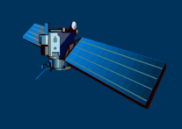
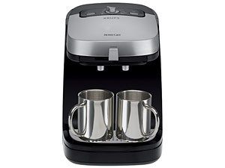
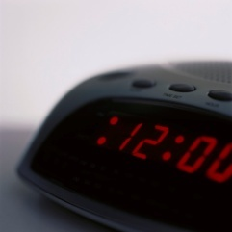
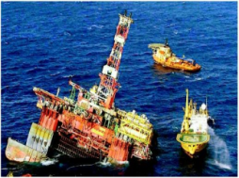
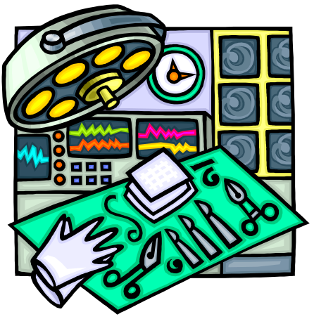

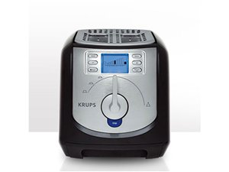


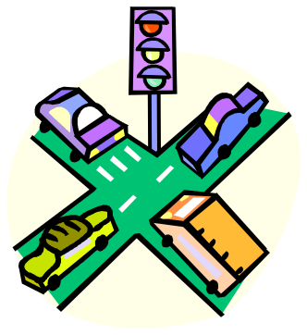


Software is a Skin that Surrounds Our Civilization
Quote due to Dr. Mark Harman

Slide 4
Software is a Skin that Surrounds Our Civilization
Quote due to Dr. Mark Harman

Slide 5
Software Faults, Errors & Failures
Software Fault : A static defect in the software
Defect
  It is synonymous of fault
Software Failure : External, incorrect behavior with respect to the requirements or other description of the expected behavior
Software Error : An incorrect internal state that is the manifestation of some fault
Fault : It is a condition that causes the software to fail to perform its required function.
Faults in software are equivalent to design mistakes in hardware.

Slide 6
A Concrete Example
Fault: Should start searching at 0, not 1
public static int numZero (int [ ] arr)
{ // Effects: If arr is null throw NullPointerException
// else return the number of occurrences of 0 in arr
int count = 0;
for (int i = 1; i < arr.length; i++)
{
if (arr [ i ] == 0)
{
count++;
}
}
return count;
}
Test 1
[ 2, 7, 0 ]
Expected: 1
Actual: 1
Error: i is 1, not 0, on the first iteration
Failure: none
Test 2
[ 0, 2, 7 ]
Expected: 1
Actual: 0
Error: i is 1, not 0
Error propagates to the variable count
Failure: count is 0 at the return statement

Slide 7
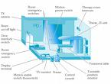
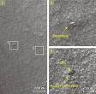

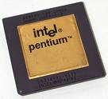
Spectacular Software Failures
NASA’s Mars lander: September 1999, crashed due to a units integration fault
THERAC-25 design
Mars Polar
Lander crash
site?
THERAC-25 radiation machine : Poor testing of safety-critical software can cost lives : 3 patients were killed
Ariane 5:
exception-handling
bug : forced self
destruct on maiden
flight (64-bit to 16-bit
conversion: about
370 million $ lost)
Ariane 5 explosion : Very expensive
Intel’s Pentium FDIV fault : Public relations nightmare.1 in 9 billion floating point divides with random parameters would produce inaccurate results
We need our software to be dependable
Testing is one way to assess dependability

Slide 8

Northeast Blackout of 2003
508 generating units and 256 power plants shut down
Affected 10 million people in Ontario, Canada
Affected 40 million people in 8 US states
Financial losses of
$6 Billion USD
The alarm system in the energy management system failed due to a software error and operators were not informed of the power overload in the system

Slide 9
Costly Software Failures
NIST report, “The Economic Impacts of Inadequate Infrastructure for Software Testing” (2002)
  Inadequate software testing costs the US alone between $22 and $59 billion annually
  Better approaches could cut this amount in half
Huge losses due to web application failures
  Financial services : $6.5 million per hour (just in USA!)
  Credit card sales applications : $2.4 million per hour (in USA)
In Dec 2006, amazon.com’s BOGO offer turned into a double discount
2007 : Symantec says that most security vulnerabilities are due to faulty software
World-wide monetary loss due to poor software is staggering

Slide 10
Testing in the 21st Century
More safety critical, real-time software
Enterprise applications means bigger programs, more users
Paradoxically, free software increases our expectations !
Security is now all about software faults
  Secure software is reliable software
The web offers a new deployment platform
  Very competitive and very available to more users
  Web apps are distributed
  Web apps must be highly reliable
Industry desperately needs our inventions !

Slide 11
What Does This Mean?
Software testing is getting more important
What are we trying to do when we test ?
What are our goals ?

Slide 12
Validation & Verification (IEEE)
Validation : The process of evaluating software at the end of software development to ensure compliance with intended usage
Verification : The process of determining whether the products of a given phase of the software development process fulfill the requirements established during the previous phase

Slide 13
Cost of Not Testing
Poor Program Managers might say: “Testing is too expensive.”
Testing is the most time consuming and expensive part of software development
Not testing is even more expensive
If we have too little testing effort early, the cost of testing increases
Planning for testing after development is prohibitively expensive

Slide 14
Cost of Late Testing
60
Assume $1000 unit cost, per fault, 100 faults
$250K
50
40
$360K
30
Fault origin (%)
Fault detection (%)
Unit cost (X)
20
$20K
$100K
$13K
10
$6K
0
Requirements
Design
Prog / Unit Test
Integration Test
System Test
Post-Deployment
Software Engineering Institute; Carnegie Mellon University; Handbook CMU/SEI-96-HB-002

Slide 15
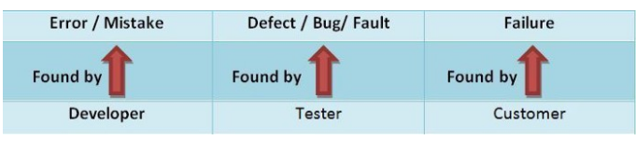
Difference

Slide 16
Summary: Why Do We Test Software ?
A tester’s goal is to eliminate faults as early as possible
Improve quality
Reduce cost
Preserve customer satisfaction

Slide 17
Most Common Software problems
    Incorrect calculation
    Incorrect data edits & ineffective data edits
    Incorrect matching and merging of data
    Data searches that yields incorrect results
    Incorrect processing of data relationship
    Incorrect coding / implementation of business rules
    Inadequate software performance

Slide 18
Most Common Software
problems
    Confusing or misleading data
    Software usability by end users &
    Obsolete Software
    Inconsistent processing
    Unreliable results or performance
    Inadequate support of business needs
    Incorrect or inadequate interfaces
      with other systems
    Inadequate performance and security controls
    Incorrect file handling

Slide 19
Objectives of testing
Executing a program with the intent of finding an error.
To check if the system meets the requirements and be executed successfully in the Intended environment.
To check if the system is “ Fit for purpose”.
To check if the system does what it is expected to do.

Slide 20
Objectives of testing
A good test case is one that has a probability of finding an as yet undiscovered error.
A successful test is one that uncovers a yet undiscovered error.
A good test is not redundant.
A good test should be “best of breed”.
A good test should neither be too simple nor too complex.

Slide 21
Objective of a Software Tester
Find bugs as early as possible and make sure they get fixed.
To understand the application well.
Study the functionality in detail to find where the bugs are likely to occur.
Study the code to ensure that each and every line of code is tested.
Create test cases in such a way that testing is done to uncover the hidden bugs and also ensure that the software is usable and reliable

Slide 22
VERIFICATION & VALIDATION
Verification - typically involves reviews and meeting to evaluate documents, plans, code, requirements, and specifications. This can be done with checklists, issues lists, walkthroughs, and inspection meeting.
Validation - typically involves actual testing and takes place after verifications are completed.
Validation and Verification process continue in a cycle till the software becomes defects free.

Slide 23
EVOLUTION OF SOFTWARE TESTING
Debugging-oriented Phase (Before 1957) This phase is the early period of testing. At that time, testing basics were unknown. Programs were written and then tested by the programmers until they were sure that all the bugs were removed. The term used for testing was checkout, focused on getting the system to run.
Demonstration-oriented Phase (1957–78) The term ‘debugging’ continued in this phase. However, in 1957, Charles Baker pointed out that the purpose of checkout is not only to run the software but also to demonstrate the correctness according to the mentioned requirements. Thus, the scope of checkout of a program increased from program runs to program correctness. Moreover, the purpose of checkout was to show the absence of errors.

Slide 24
EVOLUTION OF SOFTWARE TESTING
Destruction-oriented Phase (1979–82) This phase can be described as the revolutionary turning point in the history of software testing. Myers changed the view of testing from ‘testing is to show the absence of errors’ to ‘testing is to ﬁ nd more and more errors.’ He separated debugging from testing and stressed on the valuable test cases if they explore more bugs.
Evaluation-oriented Phase (1983–87) With the concept of early testing, it was realized that if the bugs were identiﬁ ed at an early stage of development, it was cheaper to debug them as compared to the bugs found in implementation or post-implementation phases. This phase stresses on the quality of software products such that it can be evaluated at every stage of development. In fact, the early testing concept was established in the form of veriﬁ cation and validation activities which help in producing better quality software.

Slide 25
EVOLUTION OF SOFTWARE TESTING
Prevention-oriented Phase (1988–95) The evaluation model stressed on the concept of bug-prevention as compared to the earlier concept of bug-detection. With the idea of early detection of bugs in earlier phases, we can prevent the bugs in implementation or further phases. Beyond this, bugs can also be prevented in other projects with the experience gained in similar software projects.
Process-oriented Phase (1996 onwards) In this phase, testing was established as a complete process rather than a single phase (performed after coding) in the software development life cycle (SDLC). The testing process starts as soon as the requirements for a project are speciﬁ ed and it runs parallel to SDLC. Moreover, the model for measuring the performance of a testing process has also been developed like CMM. The model for measuring the testing process is known as Testing Maturity Model (TMM).

Slide 26
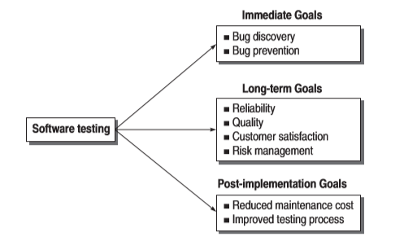

GOALS OF SOFTWARE TESTING

Slide 27
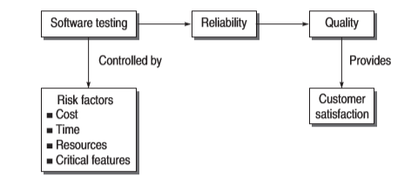
GOALS OF SOFTWARE TESTING

Slide 28
Test Case
In the simplest form, a test case is a set of conditions or variables under which a tester determines whether the software satisfies requirements and functions properly.
A test case usually contains:
(Simplest Form)
TEST Case ID
Description
Inputs
Expected result
Actual result (once tested)
Pass/Fail

Slide 29
Test Case
A,B
if(A>B)
cout<<”A is Greater”;
else
cout<<”B is Greater”;
Endif

Slide 30
Test Case
A,B
if(A>B)
cout<<”A is Greater”;
else
cout<<”B is Greater”;
Endif
Test Case- TC1
A=10,B=20 Expected Output- B is Greater
Test Case- TC2
A=20,B=10 Expected Output- A is Greater

Slide 31
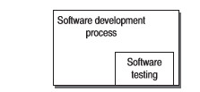
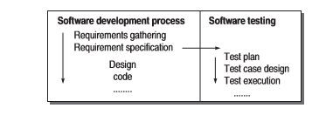
SOFTWARE TESTING AS A PROCESS
SOFTWARE TESTING AS A PHASE
SOFTWARE TESTING AS A PROCESS

Slide 32
SOFTWARE TESTING AS A PROCESS
Software testing process must be planned, speciﬁed, designed, implemented, and quantiﬁed. Testing must be governed by the quality attributes of the software product. Thus, testing is a dual-purpose process, as it is used to detect bugs as well as to establish conﬁ dence in the quality of software.
An organization, to ensure better quality software, must adopt a testing process and consider the following points:
Testing process should be organized such that there is enough time for important and critical features of the software
Testing techniques should be adopted such that these techniques detect maximum bugs.
Quality factors should be quantiﬁed so that there is a clear understanding in running the testing process. In other words, the process should be driven by quantiﬁed quality goals. In this way, the process can be monitored and measured. Testing procedures and steps must be deﬁned and documented.
There must be scope for continuous process improvement.

Slide 33
LIFE CYCLE OF A BUG
It should be clear that any member of the development team can make an error in any phase of SDLC.
If an error has been produced in the requirement speciﬁcation phase and not detected in the same phase, then it results in a bug in the next phase, i.e. the design phase.
In the design phase, a bug has come from the previous stage, but an error can also be produced in this stage. Again, if the error in this phase is not detected and it passes on to the next stage, i.e. coding phase, then it becomes a bug.
In this way, errors and bugs appear and travel through various stages of SDLC

Slide 34
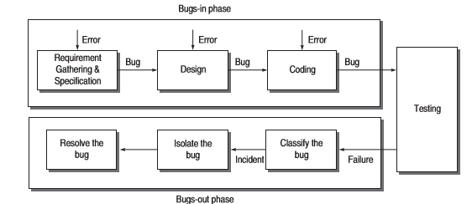
LIFE CYCLE OF A BUG

Slide 35
LIFE CYCLE OF A BUG
Bugs-In Phase
This phase is where the errors and bugs are introduced in the software. Whenever we commit a mistake, it creates errors on a speciﬁc location of the software and consequently, when this error goes unnoticed, it causes some conditions to fail, leading to a bug in the software. This bug is carried out to the subsequent phases of SDLC, if not detected. Thus, a phase may have its own errors as well as bugs received from the previous phase. If you are not performing veriﬁ cation on earlier phases, then there is no chance of detecting these bugs.

Slide 36
LIFE CYCLE OF A BUG
Bugs-Out Phase
If failures occur while testing a software product, we come to the conclusion that it is affected by bugs. However, there are situations when bugs are present, even though we don’t observe any failures. In this phase, when we observe failures, the following activities are performed to get rid of the bugs.
Bug classiﬁcation
Bug isolation
Bug resolution

Slide 37
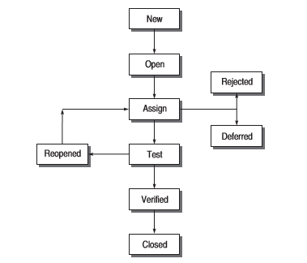
States of Bug

Slide 38
States of Bug
New
The state is new when the bug is reported ﬁrst time by a tester.
Open
The new state does not verify that the bug is genuine. When the test leader approves that the bug is genuine, its state becomes open.
Assign
An open bug comes to the development team where the development team veriﬁ es its validity. If the bug is valid, a developer is assigned the job to ﬁx it and the state of the bug now is ‘ASSIGN’.

Slide 39
States of Bug
Deferred
The developer who has been assigned to ﬁx the bug will check its validity and priority. If the priority of the reported bug is not high or there is not sufﬁcient time to test it or the bug does not have any adverse effect on the software, then the bug is changed to deferred state which implies the bug is expected to be ﬁxed in next releases.
Rejected It may be possible that the developer rejects the bug after checking its validity, as it is not a genuine one.

Slide 40
States of Bug
Test
After ﬁxing the valid bug, the developer sends it back to the testing team for next round of checking. Before releasing to the testing team, the developer changes the bug’s state to ‘TEST’. It speciﬁ es that the bug has been ﬁxed by the development team but not tested and is released to the testing team.
Veriﬁed/ﬁxed The tester tests the software and veriﬁes whether the reported bug is ﬁxed or not. After verifying, the developer approves that the bug is ﬁxed and changes the status to ‘VERIFIED’.

Slide 41
States of Bug
Reopened If the bug is still there even after ﬁxing it, the tester changes its status to ‘REOPENED’. The bug traverses the life cycle once again. In another case, a bug which has been closed earlier may be reopened if it appears again. In this case, the status will be REOPENED instead of OPEN.
Closed
Once the tester and other team members are conﬁ rmed that the bug is completely eliminated, they change its status to ‘CLOSED’

Slide 42
BUG CLASSIFICATION
BASED ON CRITICALITY
Critical Bugs This type of bugs has the worst effect such that it stops or hangs the normal functioning of the software. The person using the software becomes helpless when this type of bug appears. For example, in a sorting program, after providing the input numbers, the system hangs and needs to be reset.
Major Bug
This type of bug does not stop the functioning of the software but it causes a functionality to fail to meet its requirements as expected. For example, in a sorting program, the output is being displayed but not the correct one.

Slide 43
BUG CLASSIFICATION
BASED ON CRITICALITY
Medium Bugs Medium bugs are less critical in nature as compared to critical and major bugs. If the outputs are not according to the standards or conventions, e.g. redundant or truncated output, then the bug is a medium bug.
Minor Bugs These types of bugs do not affect the functionality of the software. These are just mild bugs which occur without any effect on the expected behaviour or continuity of the software. For example, typographical error or misaligned printout.

Slide 44
BUG CLASSIFICATION BASED ON SDLC
Requirements and Speciﬁcations
Bugs The ﬁrst type of bug in SDLC is in the requirement gathering and speciﬁ cation phase. It has been observed that most of the bugs appear in this phase only. If these bugs go undetected, they propagate into subsequent phases.
There may be a possibility that requirements speciﬁed are not exactly what the customers want. Moreover, speciﬁed requirements may be incomplete, ambiguous, or inconsistent. Speciﬁcation problems lead to wrong missing, features
Design Bugs
Design bugs may be the bugs from the previous phase and in addition those errors which are introduced in the present phase. The following design errors may be there.
Control ﬂow bugs
If we look at the control ﬂow of a program then there may be many errors. For example, some paths through the ﬂ ow may be missing; there may be unreachable paths, etc.

Slide 45
BUG CLASSIFICATION BASED ON SDLC
Logic bugs
Any type of logical mistakes made in the design is a logical bug. For example, improper layout of cases, missing cases, improper combination of cases, misunderstanding of the semantics of the order in which a Boolean expression is evaluated.
Processing bugs
Any type of computation mistakes result in processing bugs. Examples include arithmetic error, incorrect conversion from one data representation to another, ignoring overﬂ ow, improper use of logical operators, etc.
Data ﬂow bugs
Control ﬂow cannot identify data errors. For this, we use data ﬂow There may be data ﬂow anomaly errors like un-initialized data, initialized in wrong format, data initialized but not used, data used but not initialized, redeﬁ ned without any intermediate use, etc.

Slide 46
BUG CLASSIFICATION BASED ON SDLC
Error handling bugs
There may be errors about error handling in the software. There are situations in the system when exception handling mechanisms must be adopted. If the system fails, then there must be an error message or the system should handle the error in an appropriate way. If you forget to do all this, then error handling bugs appear.
Boundary-related bugs
Most of the time, the designers forget to take into consideration what will happen if any aspect of a program goes beyond its minimum and maximum values. For example, there is one integer whose range is between 1 to 100. What will happen if a user enters a value as 1 or 101? When the software fails at the boundary values, then these are known as boundary-related bugs. There may be boundaries in loop, time, memory, etc.

Slide 47
BUG CLASSIFICATION BASED ON SDLC
System Bugs
There may be bugs while testing the system as a whole based on various parameters like performance, stress, compatibility, usability, etc. For example, in a real-time system, stress testing is very important, as the system must work under maximum load. If the system is put under maximum load at every factor like maximum number of users, maximum memory limit, etc. and if it fails, then there are system bugs.
Testing Bugs
One can question the presence of bugs in the testing phase because this phase is dedicated to ﬁ nding bugs. But the fact is that bugs are present in testing phase also. After all, testing is also performed by testers – humans. Some testing mistakes are: failure to notice/report a problem, failure to use the most promising test case, failure to make it clear how to reproduce the problem, failure to check for unresolved problems just before the release, failure to verify ﬁ xes, failure to provide summary report.

Slide 48
BUG CLASSIFICATION BASED ON SDLC
User interface bugs There may be some design bugs that are related to users. If the user does not feel good while using the software, then there are user interface bugs. Examples include inappropriate functionality of some features; not doing what the user expects; missing, misleading, or confusing information; wrong content in the help text; inappropriate error messages, etc.
Race condition bugs
A race condition is a situation that may occur inside a critical section. This happens when the result of multiple thread execution in critical section differs according to the order in which the threads execute.

Slide 49
BUG CLASSIFICATION BASED ON SDLC
Coding Bugs
There may be a long list of coding bugs. If you are a programmer, then you are aware of some common mistakes made. For example, undeclared data, undeclared routines, dangling code, typographical errors, documentation bugs, i.e. erroneous comments lead to bugs in maintenance.
Interface and Integration
Bugs External interface bugs include invalid timing or sequence assumptions related to external signals, misunderstanding external input and output formats, and user interface bugs. Internal interface bugs include input and output format bugs, inadequate protection against corrupted data, wrong subroutine call sequence, call parameter bugs, and misunderstood entry or exit parameter values. Integration bugs result from inconsistencies or incompatibilities between modules discussed in the form of interface bugs. There may be bugs in data transfer and data sharing between the modules.

Slide 50
MCQ
Bug discovery is a _______ goal of software testing.
(a) Long-term (b) Short-term (c) Post-implementation (d) All
Customer satisfaction and risk management are _______ goals of software testing.
(a) Long-term (b) Short-term (c) Post-implementation (d) All
Software testing produces ______.
(a) Reliability (b) Quality (c) Customer Satisfaction (d) All
Testing is the process of ______ errors.
(a) Hiding (b) Finding (c) Removing (d) None

Slide 51
Testing Principles
Effective Testing not Exhaustive Testing
Testing is not a single phase performed in SDLC
Destructive approach for constructive testing
Early Testing is the best policy.
The Pareto principle applies to software testing.The probability of the existence of an error in a section of a program is proportional to the number of errors already found in that section.
Testing strategy should start at the smallest module level and expand toward the whole program.

Slide 52
Testing Principles
Testing should also be performed by an independent team.
All tests should be traceable to customer requirements.
Everything must be recorded in software testing.
Invalid inputs and unexpected behavior have a high probability of finding an error.
Testers must participate in specification and design reviews.

Slide 53
Insights from a Venn Diagram
Testing is fundamentally concerned with behavior, and behavior is orthogonal to the code-based view common to software (and system) developers. A quick distinction is that the code-based view focuses on what it is and the behavioral view considers what it does.
One of the continuing sources of difficulty for testers is that the base documents are usually written by and for developers; the emphasis is therefore on code-based, instead of behavioral, information.
We develop a simple Venn diagram that clarifies several questions about testing.

Slide 54
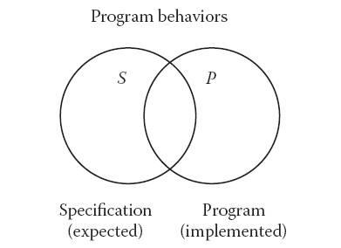
Insights from a Venn Diagram
Consider a universe of program behaviors. (Notice that we are forcing attention on the essence of testing.) Given a program and its specification, consider the set S of specified behaviors and the set P of programmed behaviors. Of all the possible program behaviors, the specified ones are in the circle labeled S and all those behaviors actually programmed are in P. With this diagram, we can see more clearly the problems that confront a tester. What if certain specified behaviors have not been programmed? In terminology, these are faults of omission(something Left out)

Slide 55
Insights from a Venn Diagram
Similarly, what if certain programmed (implemented) behaviors have not been specified? These correspond to faults of commission(incorrect entry) and to errors that occurred after the specification was complete. The intersection of S and P (the football-shaped region) is the “correct” portion, that is, behaviors that are both specified and implemented. A very good view of testing is that it is the determination of the extent of program behavior that is both specified and implemented.

Slide 56
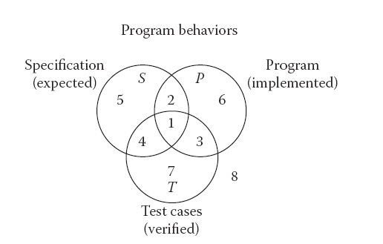
Insights from a Venn Diagram
The new circle in Figure is for test cases. Now, consider the relationships among sets S, P, and T. There may be specified behaviors that are not tested (regions 2 and 5), specified behaviors that are tested (regions 1 and 4), and test cases that correspond to unspecified behaviors (regions 3 and 7). Similarly, there may be programmed behaviors that are not tested (regions 2 and 6), programmed behaviors that are tested (regions 1 and 3), and test cases that correspond to behaviors that were not implemented (regions 4 and 7).

Slide 57
Insights from a Venn Diagram
Each of these regions is important. If specified behaviors exist for which no test cases are available, the testing is necessarily incomplete.
Let us consider a program. Let S be the set of specified behaviours of the
program, P be the implementation of the program, and T be the set of test
cases. Now consider the following cases (see Fig.
(i) There may be specified behaviours that are not tested (regions 2 and 5).
(ii) Test cases that correspond to unspecified behaviours (regions 3 and 7).
(iii) Program behaviours that are not tested (regions 2 and 6).
The good view of testing is to enlarge the area of region 1. Ideally, all three
sets S, P, and T must overlap each other such that all specifi cations are implemented
and all implemented specifi cations are tested. This is possible only
when the test team members participate in all discussions regarding specifi cations
and design.

Slide 58
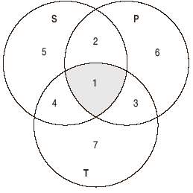

Slide 59
Identifying Test Cases
Two fundamental approaches are used to identify test cases; traditionally, these have been called
functional (Specification-based ) and
structural testing (code-based )

Slide 60
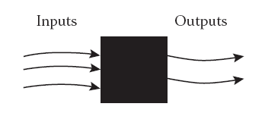
Specification-based
The reason that specification-based testing was originally called “functional testing” is that any program can be considered to be a function that maps values from its input domain to values in its output range. This led to another synonymous term—black box testing, in which the content (implementation) of the black box is not known, and the function of the black box is understood completely in terms of its inputs and outputs

Slide 61
Specification-based
With the specification-based approach to test case identification, the only information used is the specification of the software. Therefore, the test cases have two distinct advantages: (1) they are independent of how the software is implemented, so if the implementation changes, the test cases are still useful; and (2) test case development can occur in parallel with the implementation, thereby reducing the overall project development interval. On the negative side, specification based test cases frequently suffer from two problems: significant redundancies may exist among test cases, compounded by the possibility of gaps of untested software.

Slide 62
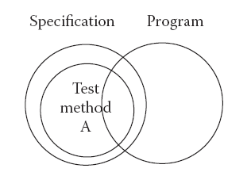

Slide 63
Code-Based Testing
Code-based testing is the other fundamental approach to test case identification. To contrast it with black box testing, it is sometimes called white box (or even clear box) testing. The clear box metaphor is probably more appropriate because the essential difference is that the implementation (of the black box) is known and used to identify test cases. The ability to “see inside” the black box allows the tester to identify test cases on the basis of how the function is actually implemented.

Slide 64
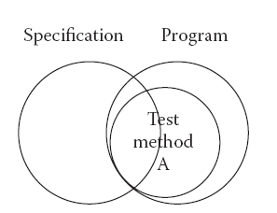
Code-Based Testing

Slide 65
Specification-Based versus Code-Based Debate
Neither approach by itself is sufficient. Consider program behaviors: if all specified behaviors have not been implemented, code-based test cases will never be able to recognize this.
Conversely, if the program implements behaviors that have not been specified, this will never be revealed by specification-based test cases. Judicious combination will provide the confidence of specification-based testing and the measurement of code-based testing.

Slide 66
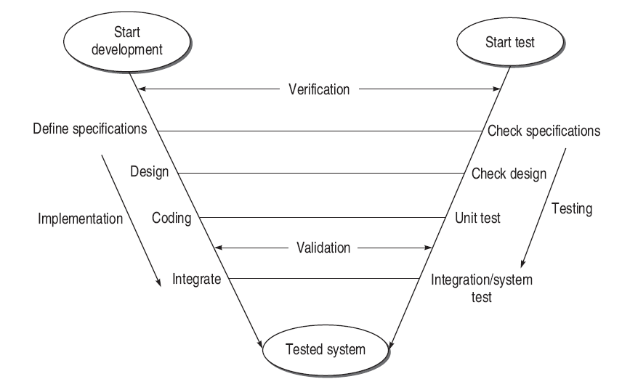
Levels of testing

